Slide 1
Selenium
By Smita B Kumar

Slide 2
Day3 Module 10: Efficient Selenium Scripting and Troubleshoot Scenarios
JavaScript Executors Accessing multiple links Accessing multiple elements in a List Handling keyboard and mouse events

Slide 3
Introduction
We would now shift our focus towards a few trivial yet important topics that would guide us troubleshoot some recurrent problems. We may or may not use them in daily scripting but they would be helpful in the long run.
We would discuss some advance concepts where in we would deal with mouse and keyboard events, accessing multiple links by implementing lists.

Slide 4
JavaScript Executors
While automating a test scenario, there are certain actions those become an inherent part of test scripts.
These actions may be:
Clicking a button, hyperlink etc.
Typing in a text box
Scrolling Vertically or Horizontally until the desired object is brought into view
And many more
Now, it is evident from the earlier modules that the best way to automate such actions is by using Selenium commands.
But what if the selenium commands don’t work?
Yes, it is absolutely possible that the very basic and elementary Selenium Commands don’t work in certain situations.
That said, to be able to troubleshoot such situation, we shoulder JavaScript executors into the picture.

Slide 5
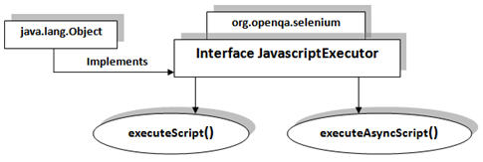
What are JavaScript Executors?
JavascriptExecutor interface is a part of org.openqa.selenium and implements java.lang.Object class.
JavascriptExecutor presents the capabilities to execute JavaScript directly within the web-browser.
To be able to execute the JavaScript, certain mechanisms in the form of methods along with a specific set of parameters are provided in its implementation.

Slide 6
JavaScript Executors- Methods
Methods
executeScript (String script, args)
As the method name suggests, it executes the JavaScript within the current window, alert, frame etc (the window that the WebDriver instance is currently focusing on)
executeAsyncScript (String script, args)
As the method name suggests, it executes the JavaScript within the current window, alert, frame etc (the window that the WebDriver instance is currently focusing on)
The parameters and import statement are common to both the executor methods.

Slide 7
JavaScript Executors- Parameters
Parameters Script – the script to be executed Argument – the parameters that the script requires for its execution (if any)
Import statement To be able to use JavascriptExecutors in our test scripts, we need to import the package using the following syntax:
import org.openqa.selenium.JavascriptExecutor;

Slide 8
JavaScript Executors- Sample Code
#1) Clicking a web element
// Locating the web element using id
WebElement element = driver.findElement(By.id("id of the webelement"));
// Instantiating JavascriptExecutor
JavascriptExecutor js = (JavascriptExecutor)driver;
// Clicking the web element
js.executeScript("arguments[0].click();", element);

Slide 9
JavaScript Executors- Sample Code
#2) Typing in a Text Box
// Instantiating JavascriptExecutor
JavascriptExecutor js = (JavascriptExecutor)driver;
// Typing the test data into Textbox
js.executeScript("document.getElementById(‘id of the element’).value=’test data’;”);

Slide 10
JavaScript Executors- Sample Code
#3) Scrolling down until the web element is in the view
WebElement element=driver.findElement(By.xpath("//input[contains(@value,'Save')]"));
// Instantiating the javascriptExecutor and scrolling into the view in the single test step
((JavascriptExecutor)driver).executeScript("arguments[0].scrollIntoView(true);",element);
You may find various other ways of writing down the code for accessing JavascriptExecutors.

Slide 11
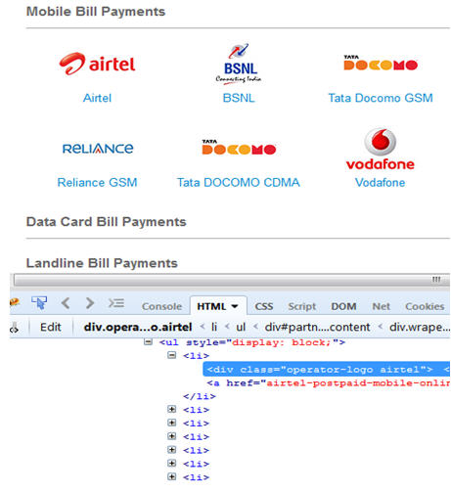
Accessing multiple elements in a List
At times, we may come across elements of same type like multiple hyperlinks, images etc arranged in an ordered or unordered list.
Thus, it makes absolute sense to deal with such elements by a single piece of code and this can be done using WebElement List.
Refer the screenshot below to understand the elements I am talking about.

Slide 12
Accessing multiple elements in a List
In the image, we see that the various service providers belong to an unordered list. Thus, verification of click ability and visibility of these elements can be done by a single piece of code by using a list of elements.
Import statement To be able to use WebElement list in our test scripts, we need to import the package using the following syntax:
import java.util.List;

Slide 13
Accessing multiple elements in a List-Sample Code
// Storing the list
List <WebElement> serviceProviderLinks = driver.findElements(By.xpath("//div[@id='ServiceProvider']//ul//li"));
// Fetching the size of the list
int listSize = serviceProviderLinks.size();
for (int i=0; i<listSize; i++)
{
// Clicking on each service provider link
serviceProviderLinks.get(i).click();
// Navigating back to the previous page that stores link to service providers
driver.navigate().back();
}
There are various requirements under which the lists can be used to verify the elements with suitable implementation changes.

Slide 14
Handling Keyboard Events
As also said earlier, there are n numbers of ways to deal with the same problem statement in different contexts.
Thus, at times a necessity arises to deal with a problem by changing the conventional dealing strategy with a more advance strategy. I have witnessed cases where I could not deal with alerts and pop up etc. by selenium commands thus I had to opt for different java utilities to deal with it using keyboard strokes and mouse events.
Robot class is one such option to perform keyboard events and mouse events.
Let us understand the concept with the help of a scenario and its implementation.

Slide 15
Handling Keyboard Events
Scenario:
Let us gather a situation where an unnecessary pop up appears on the screen which cannot be accepted or dismissed using Alert Interface, thus the only wise option we are left with is to close down the window using shortcut keys – “Alt + space bar + C”. Let us see how we close the pop up using Robot Class.
Before, initiating the implementation, we should import the necessary package to be able to use Robot class within our test script.

Slide 16
Handling Keyboard Events-Sample Code
Import Statement
import java.awt.Robot;
Sample Code
// Instantiating Robot class
Robot rb =new Robot();
// Calling KeyPress event
rb.keyPress(KeyEvent.VK_ALT);
rb.keyPress(KeyEvent.VK_SPACE);
rb.keyPress(KeyEvent.VK_C);
// Calling KeyRelease event
rb.keyRelease(KeyEvent.VK_C);
rb.keyRelease(KeyEvent.VK_SPACE);
rb.keyRelease(KeyEvent.VK_ALT);
Robot class can also be used to handle mouse events but let us here look at the selenium’s capabilities to handle mouse events.

Slide 17
Handling Mouse Events
WebDriver offers a wide range of interaction utilities that the user can exploit to automate mouse and keyboard events. Action Interface is one such utility which simulates the single user interactions.
Thus, we would witness Action Interface to mouse hover on a drop down which then opens a list of options in the next scenario.
Scenario:
Mouse Hover on the dropdown
Click on one of the items in the list options

Slide 18
Handling Mouse Events-Sample Code
Import Statement
import org.openqa.selenium.interactions.Actions;
Sample Code
// Instantiating Action Interface
Actions actions=<strong>new</strong> Actions(driver);
// howering on the dropdown
actions.moveToElement(driver.findElement(By.<em>id</em>("id of the dropdown"))).perform();
// Clicking on one of the items in the list options
WebElement subLinkOption=driver.findElement(By.id("id of the sub link"));
subLinkOption.click();

Slide 19
Conclusion
In this module, we discussed some advance topics related to efficient scripting and to troubleshoot scenarios where the user is required to handle mouse and keyboard events.
We also discussed how to store more than one web element in a list.

